Slide 1


G. H. RAISONI COLLEGE OF ENGG. & MANAGEMENT Gat No. 1200, Wagholi, Pune – 412 207 An Autonomous Institute Affiliated to Savitribai Phule Pune University
Session 2020-21
Sub – Computer programming
Presentation on
“In C – For,Break,Continue ”
By
C69 - SUSHMA DIPAK YEMMEWAR
C71 - TANMAY RADHAKRISHNA ASWALE
C70 - SWAYAM PRAMOD TERODE
C72 - VALLABH RAJARAM SHRIMANGALE
Faculty Name: Prof. NITESH DANGARE
FY B.Tech : Div C

Slide 2
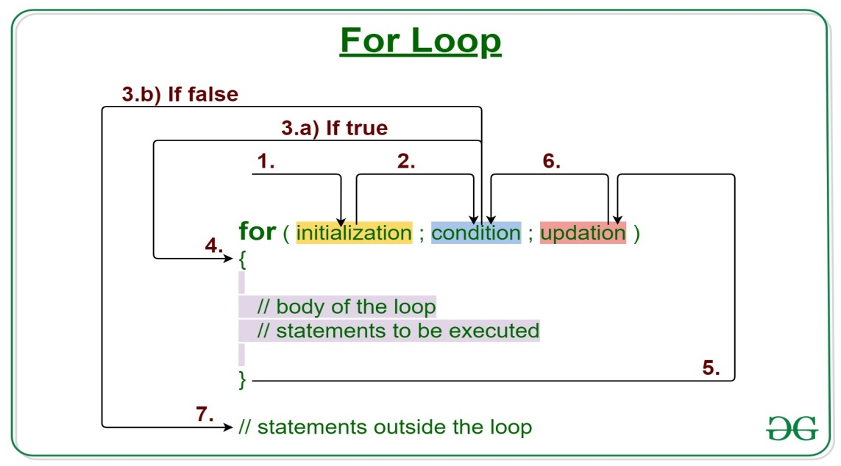
FOR LOOP IN C
EXAMPLE -
#include <stdio.h>
int main()
{
int num = 10
int i;
for(i = 0; i < num; i++) {
printf("%d ",i);
}
return 0;
}
OUTPUT – 0 1 2 3 4 5 6 7 8 9
Loop is one of the most important concepts in all programming languages as it simplifies complex problems and makes it easier to read and understand the code.
The "For" Loop is used to repeat a specific code until a specific condition is satisfied. The for-loop statement is very specialized. We use for a loop when we know the number of iterations we want, whereas when we do not know about the number of iterations, we use while loop.
initialize counter: It will initialize the loop counter value, i.e., i=0.
test counter: It verifies whether the condition is true.
Increment/decrement counter: Incrementing or decrementing the counter.
Set of statements: Execute the set of statements
The syntax of the for loop is
for ( initialize counter ; test counter ; increment/decrement counter) { //set of statements}

Slide 3
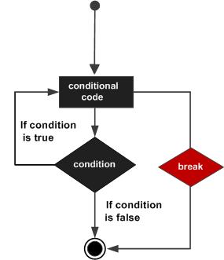
BREAK STATEMENT
Break Statement :
Break statement is used to break the loop or switch case statements execution and brings the control to the next block of code after loop or switch case.
Break statements are used to bring the program control out of the loop.
The break statement is used inside loops or switch statement in C Language.
Syntax
The syntax for a break statement in C is as follows −
break;
EXAMPLE –
For( i=0; i<1000; i++)
{
printf( “%d\n”, i );
If ( i==5 ) {
break;
}
}
OUTPUT – 0 1 2 3 4 5
( not 0 to 1000)

Slide 4
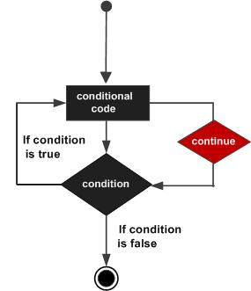
CONTINUE STATEMENT
The continue statement is used inside loops in C Language. When a continue statement is encountered inside the loop, control jumps to the beginning of the loop for next iteration, skipping the execution of statements inside the body of loop after continue statement.
It is used to bring the control to the next iteration of the loop.
The continue statement skips some code inside the loop and continues with the next iteration.
It is mainly used for a condition so that we can skip some lines of code for a particular condition.
It forces next iteration in loop i.e. as break terminates the loop but continue forces the next iteration of the loop.
Syntax
The syntax for a continue statement in C is as follows −
continue;
EXAMPLE -
#include <stdio.h>
Int main()
{
for (int j=0; j<=8; j++)
{
if ( j==4){
continue;
}
printf(“%d”, j );
}
Return o;
}
OUTPUT - 0 1 2 3 5 6 7 8

Slide 5
Thank You

